Slide 1
Passing variables between pages

Slide 2
Summary of the previous lecture
Operators in PHP
Conditional Statements in PHP
Looping Statements
Arrays in PHP

Slide 3
Outline
Super Global variables
Passing form data
Passing data with sessions

Slide 4
1. Passing form data
Forms provide a mean of submitting information from the client to the server
We can create HTML forms using <form> tag
Method and action are the most common attributes of <form>

Slide 5
1. Passing form data…
action - gives the URL of the application that is to receive and process the forms data
method - sets the HTTP method that the browser uses to send the form's data to the server for processing
most common methods are POST or GET

Slide 6
1. Passing form data…
Get method : all form data is encoded into the URL, appended the action URL as query string parameters
Asad
asd@gmail.com
submit
Action page name
Input field name
Value entered by user

Slide 7
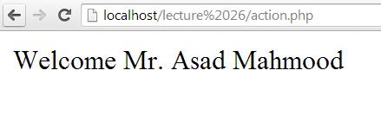
1. Passing form data…
Post method: form data appears within the message body of the HTTP request

Slide 8
1.1 Super Global Variables
PHP automatically makes few variables available in your program
These are array variables and can be accessed by name
These variables are called super-global variables because they can be accessed without regard to scope

Slide 9
1.1 Super Global Variables…
$_GET: contains all the query string variables that were attached to the URL
$_POST: contains all the submitted form variables and their data

Slide 10
1.1 Super Global Variables…
<body>
<form method=“get” action=“action.php”>
<input type=“text” name=“name”>
<input type=“text” name=“email”>
<input type=“submit”>
</form>
</body>
Asad
asd@gmail.com
submit
name
email
$_GET
Asad
asd@gmail.com

Slide 11
1.1 Super Global Variables…
<body>
<form method=“post”>
<input type=“text” name=“name”>
<input type=“text” name=“email”>
<input type=“submit”>
</form>
</body>
Asad
asd@gmail.com
submit
$_POST
Asad
asd@gmail.com
name
email

Slide 12
1.2 Accessing form data on action page
name
email
$_GET
Asad
asd@gmail.com
Ation.php
<?php
$name = $_GET[‘name’];
$email = $_GET[‘email’];
?>
Asad
asd@gmail.com
submit

Slide 13
1.2 Accessing form data on action page…
name
email
$_POST
Asad
asd@gmail.com
Ation.php
<?php
$name = $_POST[‘name’];
$email = $_POST[‘email’];
?>
Asad
asd@gmail.com
submit

Slide 14
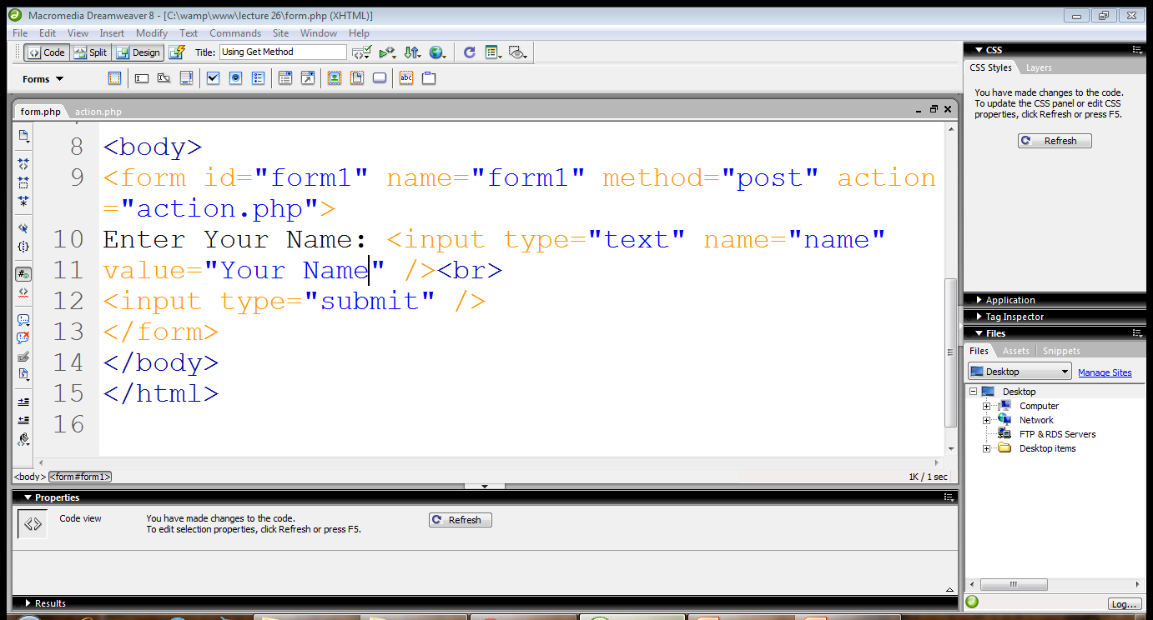
2. Passing text field data
Post Method
Text field
Text field name

Slide 15
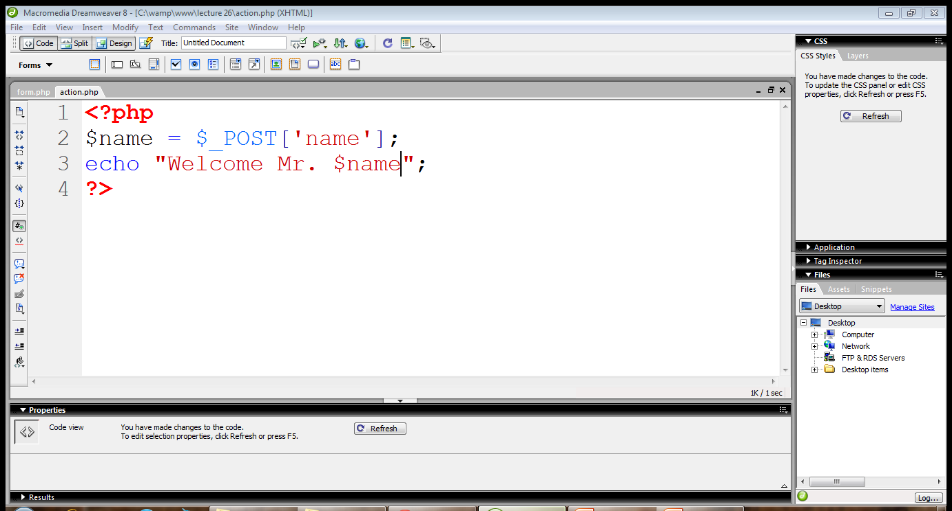
2. Passing text field data…
Data is received
Display a message

Slide 16
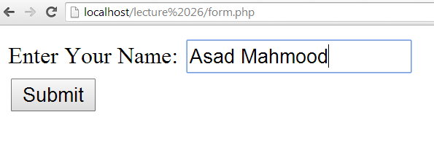
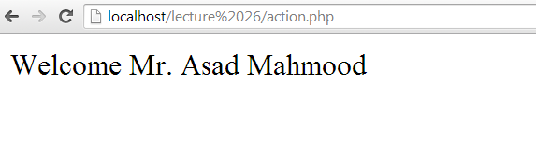
2. Passing text field data…
We are at form page
We are on action page

Slide 17
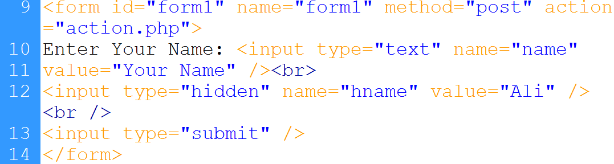
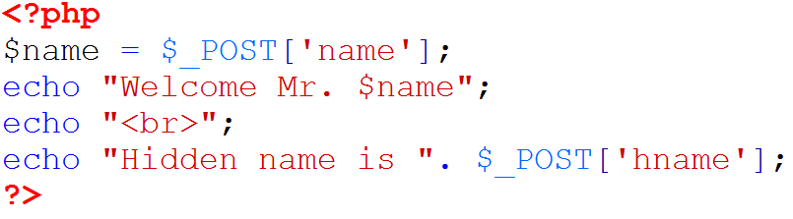
2. Passing hidden field data…
Hidden field
Field name
Hidden value
Accessing hidden value

Slide 18
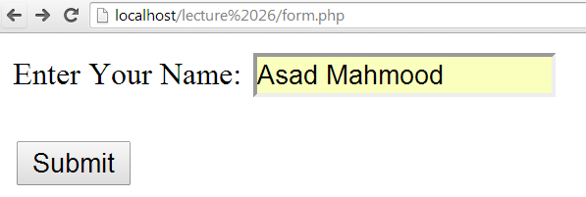
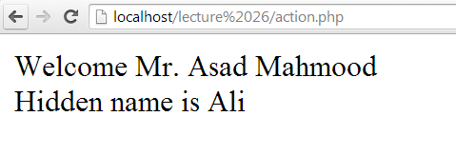
2. Passing hidden field data…

Slide 19
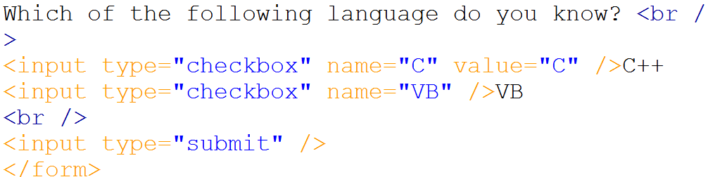
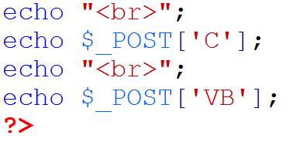
2.3 Getting value from checkbox
name
value
label
Getting value of ‘C’
Getting value of ‘VB’

Slide 20
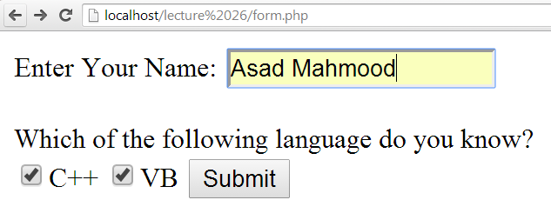
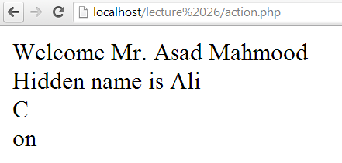
2.3 Getting value from checkbox…

Slide 21
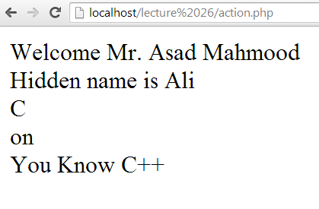
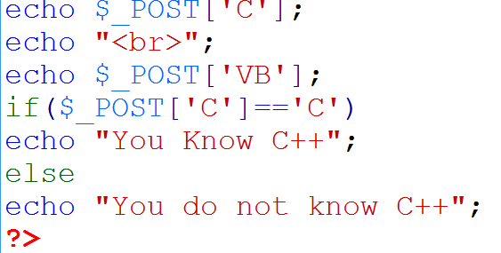
2.3 Getting value from checkbox…
Checking for value of C

Slide 22
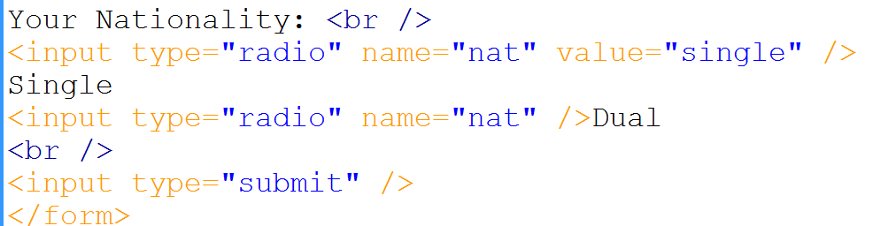
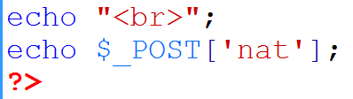
2.4 Getting value from radio button
Same name
Value is set
Value is not set
Getting value of radio

Slide 23
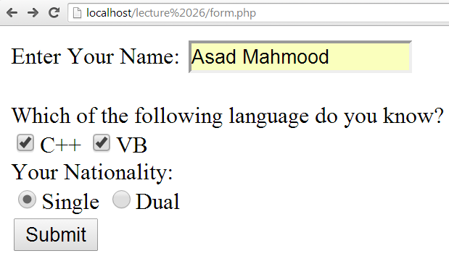
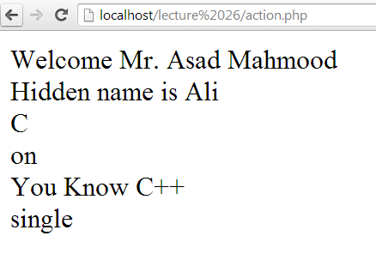
2.4 Getting value from radio button…

Slide 24
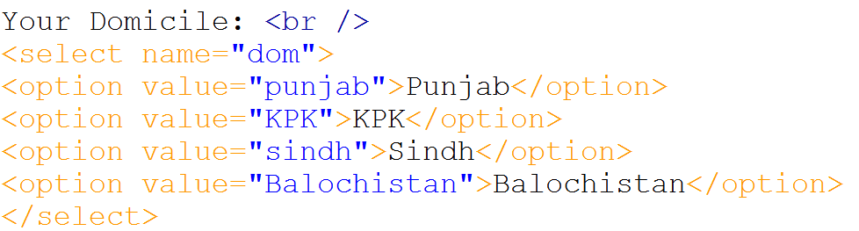
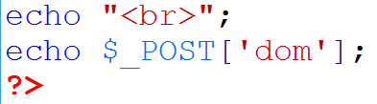
2.5 Getting value from select list
Name of the list
Option and value

Slide 25
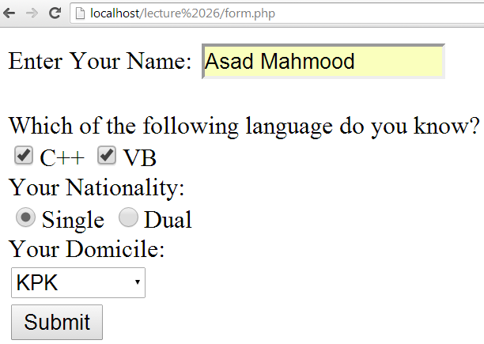
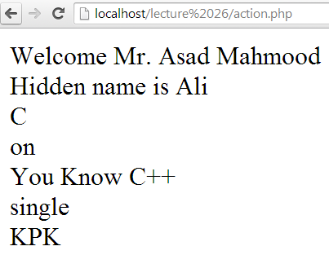
2.5 Getting value from select list…

Slide 26
3. Passing variables using sessions
A session is basically a temporary set of variables that exists only until the browser has shut down
$_SESSION: represents data available to a PHP script that has previously been stored in a session

Slide 27
3. Passing variables using sessions…
name
email
$_SESSION
Asad
asd@gmail.com
First page
<?php
$_SESSION[‘name ‘] =‘Asad’;
?>
2nd page
<?php
echo $_SESSION[‘name ‘];
$_SESSION[‘email ‘] =‘asd@gmail.com’;
?>
n^{th} page
<?php
echo $_SESSION[‘name ‘];
echo
$_SESSION[‘email ‘];
?>
…….

Slide 28
3. Passing variables using sessions
session_start()- is used to start a session
$_SESSION[‘variable_name’]- is used to store data in session variable
session_destroy()- is used to destroy a session
unset($_SESSION[‘variable_name’])- is used to unset a specific variable

Slide 29
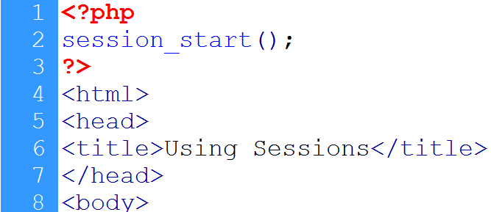
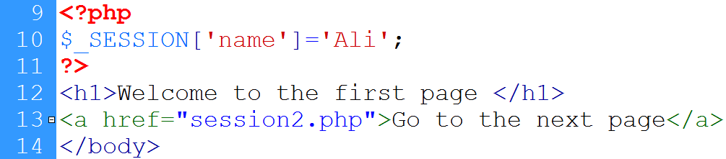
3. Passing variables using sessions…
Session starts
Session variable is created
Link to the next page

Slide 30
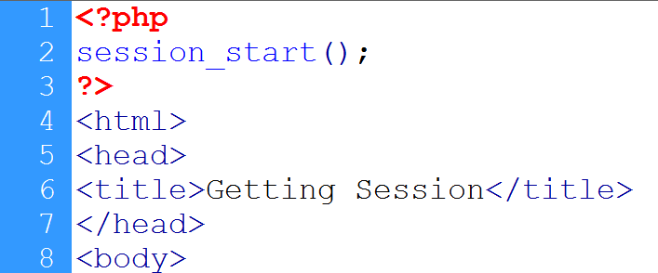
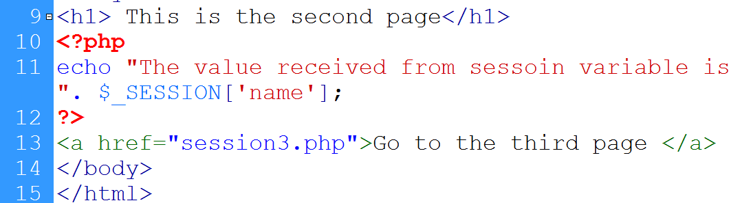
3. Passing variables using sessions…
Session starts
Session variable is accessed
link

Slide 31
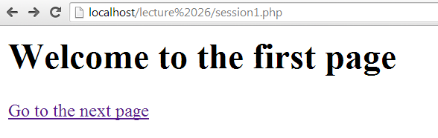
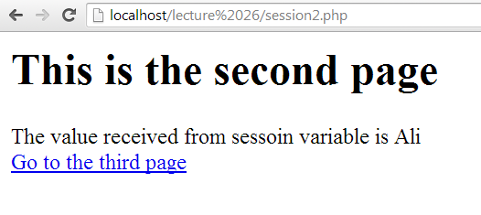
3. Passing variables using sessions…
Session variable’s value

Slide 32
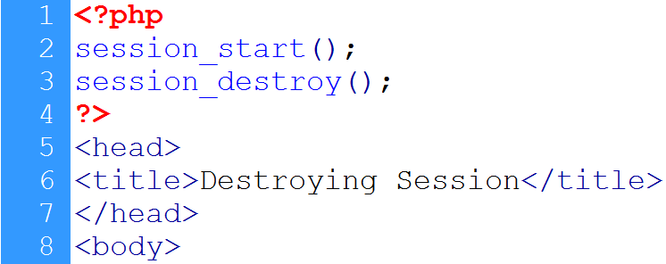
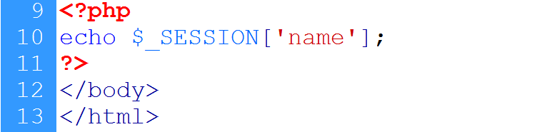
3. Passing variables using sessions…
Session is destroyed
Session is accessed

Slide 33
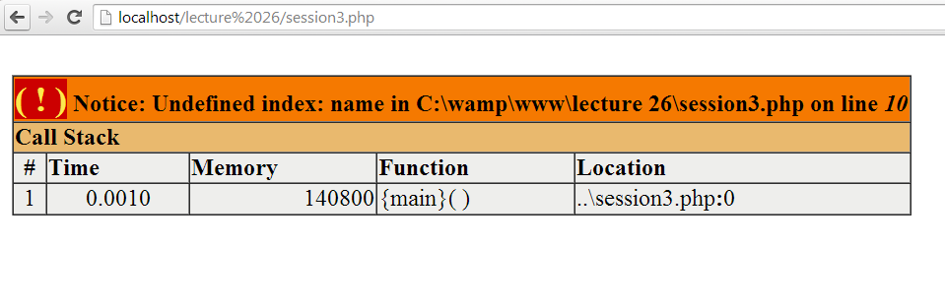
3. Passing variables using sessions…

Slide 34
Summary
Super global variables
Passing data with forms
Using session variables

Slide 35
References
Chapter 2, “Beginning PHP6,Apache,Mysql web development” by Matt Doyle, Wrox publishers, 2009, ISBN: 0470413964
Chapter 13, “Beginning PHP and MySQL” by W. Jason Gilmore, Apress publisher, 4th edition; 2010, ISBN-13 (electronic): 978-1-4302-3115-8.

